Slide 1


Impact of Science Conference the Parallel Session on:
Academic Business Relations for Innovation
25th June, 2021

Slide 2


Impact of Science
23-25 June, 2021
Heidi Kinunnen (Chair) : Vice Head of Business Collaborations at University of Helsinki, Finland
Teketel Yohannes: Executive Director of Ethiopian Academy of Sciences, Ethiopia
Ian Wright: Deputy Vice-Chancellor of Research and Innovation, University of Canterbury, New Zealand
Overview of the Speakers
#IOS21

Slide 3
Impact of Science
23-25 June, 2021
Heidi Kinunnen
Vice Head of Business Collaborations at University of Helsinki, Finland
#IOS21

Slide 4
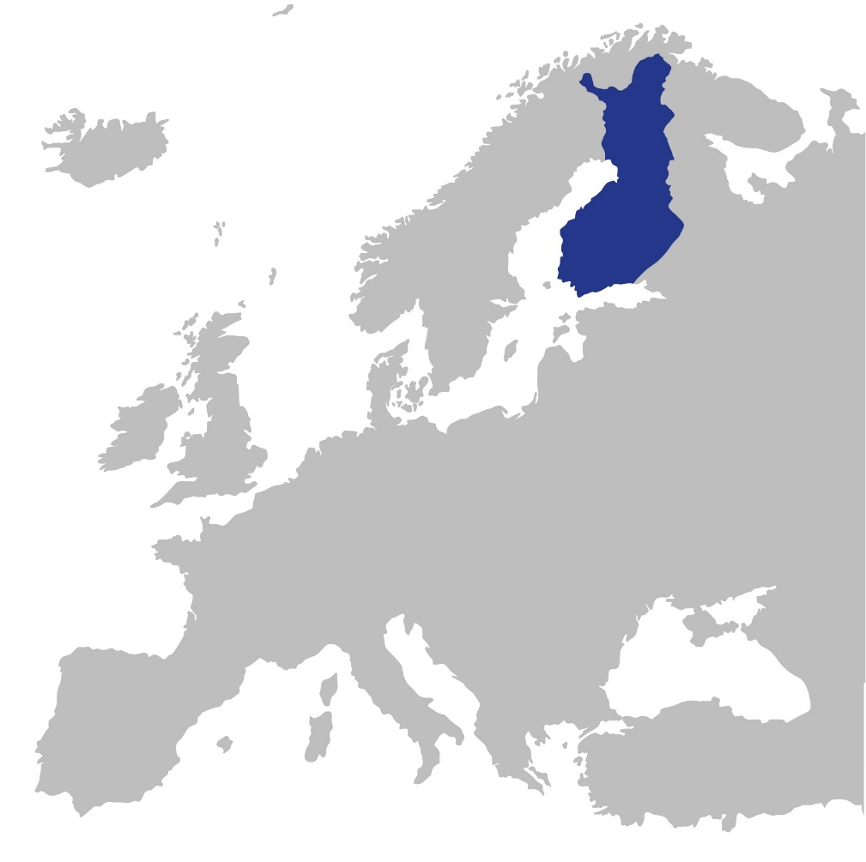
Diversity and innovations
Heidi Kinnunen
University of Helsinki
Finland

Slide 5
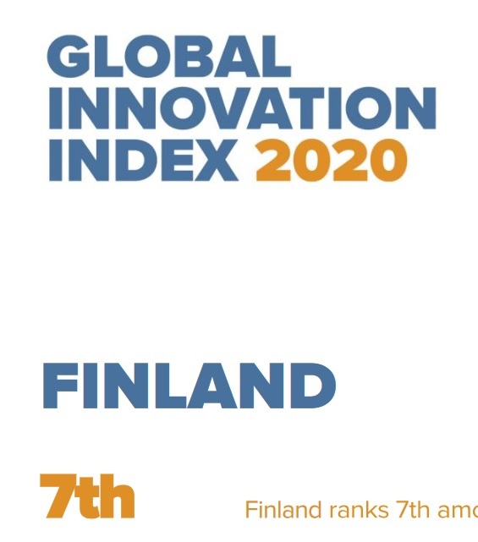
Where do innovations COME from?
Highly educated people
Favourable political / regulatory environment
Good infrastructure
Investments, VC
Incentives for innovators, entrepreneurship

Slide 6


One culture

Slide 7

Adding diversity

Slide 8



Innovations and diversity
Innovation disclosures
% of international researchers
2010 2011 2012 2013 2014 2015 2016 2017 2018 2019 2020 2021
Year
#researchers vary between 4000-4500

Slide 9
Innovations and diversity
2020
Number of innovation disclosures grown x 2,6
Percentage of international researcers has grown x 2,9
2010

Slide 10
Innovations and diversity
During the past 3 years, about 55% of invention disclosures teams have had at least one foreign inventor.
57,3% (60 out of 103 teams)
53,5% (53 out of 99 teams)
2020 58,6% (70 out of 122 teams)

Slide 11
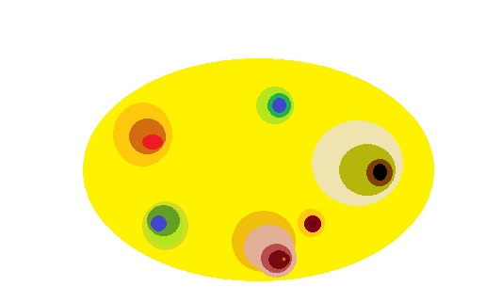

DIVERSITY AND creativity
Time and networking
increase impact.

Slide 12
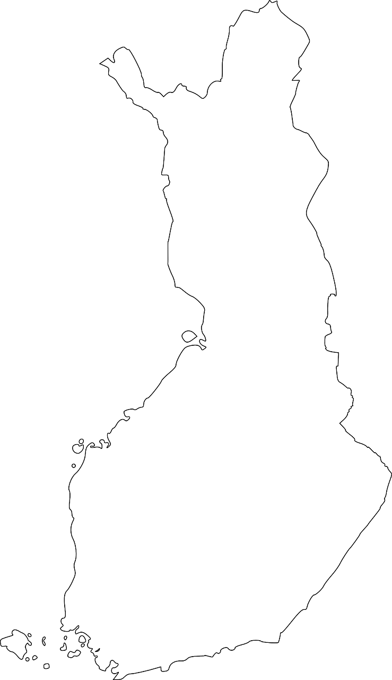

Diversity and Belonging (students)
60-70% of foreign students stay in Finland after graduation (3 years )

Slide 13

DIVERSITY AND BELONGING (researchers)
How do we build the bridge between our new foreign researchers and their colleagues and the local industry?
Social skills
Expats tend to build their own communities.
Support for networking
- crossdisciplinary
- cultures
- countries
- early career + experienced

Slide 14
Three countries, three stories
about Academic-Business Relations for Innovation
Finland
Ethiopia
New Zealand

Slide 15
Impact of Science
23-25 June, 2021
Teketel Yohannes
Executive Director of Ethiopian Academy of Sciences, Ethiopia
#IOS21

Slide 16

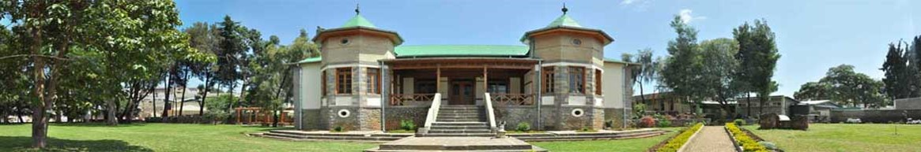
Ethiopian Academy of sciences
Teketel Yohannes, Executive Director
Email: teketel.yohannes@eas-et.org
Webpage: www.eas-et.org

Slide 17

Our Logo

Slide 18

EAS is
Merit based membership organization
  Regular Fellow
  Associate Fellow
  Honorary Fellow
Membership Requirement
Publications or Professional Contribution
Contribution to the Growth of One’s Field of Specialization
International Stature as a Scholar or Professional
Services to Society

Slide 19
General Assembly
Executive Board
EAS Secretariat
Working Groups
175 regular Fellows
63 associate Fellows
239 Fellows
1 honorary Fellow
Agriculture
Engineering & Technology
Fine Arts
Health
Natural Science
Social Science and Humanities

Slide 20
Autonomous, Non-Profit
Launched in 2010
Recognized by Act of Parliament in 2013
(Proclamation No. 783/2013)

Slide 21
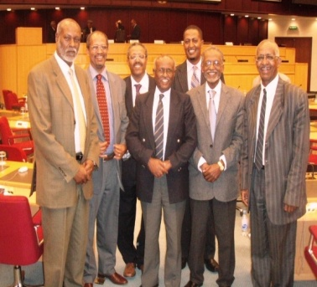
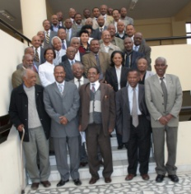
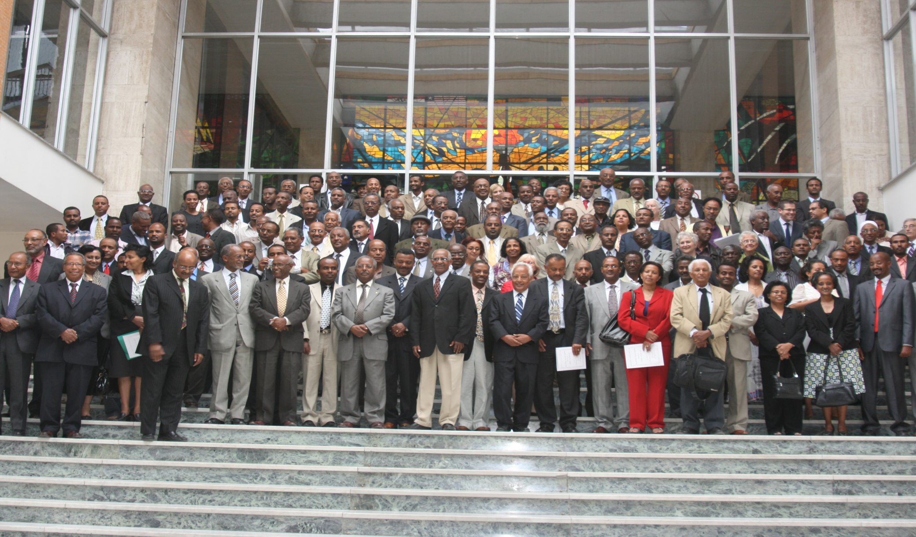
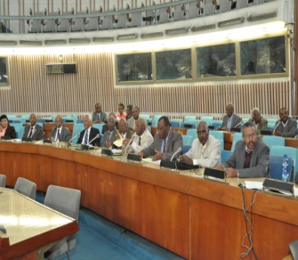
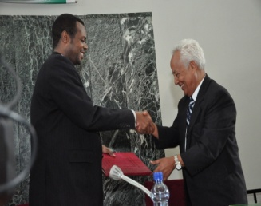
Background
Recognized as an autonomous organization by Act of Parliament:-
On 1 March 2013
Proclamation No. 783/2013
Launching Conference, 10 April 2010
Ad-hoc Committee. 2009
Founding Fellows,
2010
Re-launching Ceremony,
20 June 2013

Slide 22

Vision
To be a premium organization in the development of scientific culture and scholarship in Ethiopia, through which sustainable quality of life can be attained.

Slide 23

Mission
To foster scientific knowledge and innovation with a view to the attainment of the developmental and transformational aspirations of the people of Ethiopia.
Scope
“Sciences” refer to natural sciences, mathematics, health sciences, agricultural sciences, engineering, technology, social sciences, humanities, fine arts and letters.

Slide 24
Objectives
  Fostering scientific culture, innovation and scholarship
  Enhancing scientific researches on areas of special importance with the active involvement of Ethiopian scholars across disciplines
  Providing evidence-based policy advice on issues of national importance
  Creating a network among scholars in sciences and arts in Ethiopian and beyond
  Create appropriate channels to disseminate major findings in all disciplines; and
  Sustain the active engagement and benefits of women and other underprivileged and marginalized groups in all scientific works

Slide 25
Relationship with the Government
The Academy
gives evidence based advice to relevant Government organs on issues of science, technology, innovation and education through consensus and other studies.
The Government
Donated the former residence of Blaten Geta Hiruy Woldeselassie to serve as its headquarters (Historical Heritage of the Addis Ababa City)
Provides annual budgetary subvention.

Slide 26
Strategic Planning
  First Strategic Plan (2011 - 2015)
  Institutional capacity building, increasing visibility &networking)
  Second Strategic Plan (2016 – 2020)
  Core Programs
  1. Building the institutional capacity and ensuring the
  vibrancy and sustainability of EAS.
  2. Providing evidence-based advice.
  3. Providing consensus building platforms on critical
  national issues.
  4. Promoting science, technology and innovation
  5. Fostering national, regional and international collaboration

Slide 27

The journey so far
Since its establishment in 2010, EAS:
  Conducted Three Science Congresses of the Academy
  Conducted over 15 studies
  organized several conferences and workshops
  Conducted series of public lectures and panel discussions on topical issues
  Established Creative and Cultural Arts Center, Ethiopian Academy Press, and a library
  Established a Science Center with a STEM center to raise the passion of children for science, engineering and mathematics

Slide 28
Science Congresses/Conferences of the Academy/(Every 2 years)
First Science congress: 15-16 December 2011
  “Science and Technology—Survival of a Nation”
  About 230 participants - Representatives of ministries, NGOs, scholars, professional associations and sister academies in Africa and Europe
Ninth Annual Meeting of African Science Academies: 9 - 12 November 2013
  “Biotechnology for Africa’s Development”
  118 international and national participants

Slide 29
Second Science Congress: 26 - 27 November 2015
  “Re-envisioning Higher Education and Research in Ethiopia”
  180 Participants – Presidents and V/Presidents of Universities, professionals, policy makers and EAS members
Third Science Congress: 16-17 November 2017
  “Harnessing the Demographic Dividend: Ethiopia’s Emerging Challenge”
  Over 200 participants from various organizations participated

Slide 30
Major Studies Completed
Integration of Nutrition with Agriculture and Health
Status of Engineering & Technology Education and Research in Ethiopia
Quality of Primary education in Ethiopia
Mapping Research Landscape in the health Sector
State of Agricultural Science and Technology in Ethiopia
Consensus Study on Establishment of a National Research Council – Structure and Operation

Slide 31
Major Studies…
Assessment of the demand for and supply of trained S&T human resource – Manufacturing, Services, Agriculture & Health sectors
Developed implementation plans for the National Biotechnology Road Map
Conducted a study on National journal Evaluation and Accreditation Strategy
Conducted pilot Study on Research Mentoring in three Universities in Ethiopia

Slide 32
Major Studies…
Developed standards for undergraduate university laboratories and workshops – Biology , Chemistry, Physics & Civil & Electrical Engineering
Prepared a Road map for development of Industrial Products from Byproducts of Sugar Industries and identified policies, programs, and projects for its implementation
Conducted Assessment of Status of Climate Change in Ethiopia - 2015 (Sectoral Reports Produced in 7 volumes)
Conducted Review of green Technologies
Prepared a report on the Status and Outlook of the Ethiopian Environment -2017 (SoE-2017)

Slide 33
Major Studies…
Conducted a study on Demographic Dividend of Ethiopia and published a report titled “The Demographic Dividend: Imperative for Ethiopia’s Transformation”
Conducted a study on Population Dynamics and Priority Issues for Ethiopia’s 15-Year Perspective Development Plan (2015/16 – 2029/30)
Study on Establishment of Adwa Victory Memorial Museum
Development of Strategy for Instituting Curriculum-based Exit Exams in Ethiopia
Assessment of the Implementation of National Population policy of Ethiopia launched in 1993
Systematic Review and Policy Brief for Establishing a New Vaccine Intelligence Unit in Ethiopia

Slide 34
Major ongoing Studies/Projects
Development of Amharic Science and Technology Terms Glossary)
Preparation of Mother Tongue and English Languages Education Development Strategies
Preparation of laboratory/workshop standards for undergraduate programs of English, Chemical engineering Geography, Geology and Mechanical Engineering
Preparation of laboratory/workshop manuals for undergraduate programs in Biology, Chemistry, Civil Engineering, Chemical Engineering, Electrical Engineering, English, Geography, Geology, Mechanical Engineering and Physics)

Slide 35
Major ongoing…
Biomass Use Policy Study (በስኳር እንዱስትሪ ተረፈ-ምርት የሚመረቱ ቁልፍ ምርቶችና ተያያዥ ኢንዱስትሪዎች የባዮማስ አጠቃቀም ፖሊሲ ጥናት)
Pesticide Use Policy Study (የፀረ-ተባይ አጠቃቀም ሥርዓት ፖሊሲ ቅድመ-ጥናትና የፖሊሲ ረቂቅ ዝግጅት)
Policy Options for Improving the sanitary standards of The Ethiopian Meat Industry
Bridging Population Evidence with Policy in Ethiopia
Evaluation and Accreditation of Research Journals in Ethiopia

Slide 36
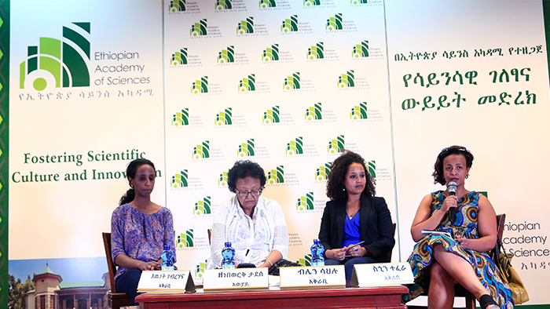
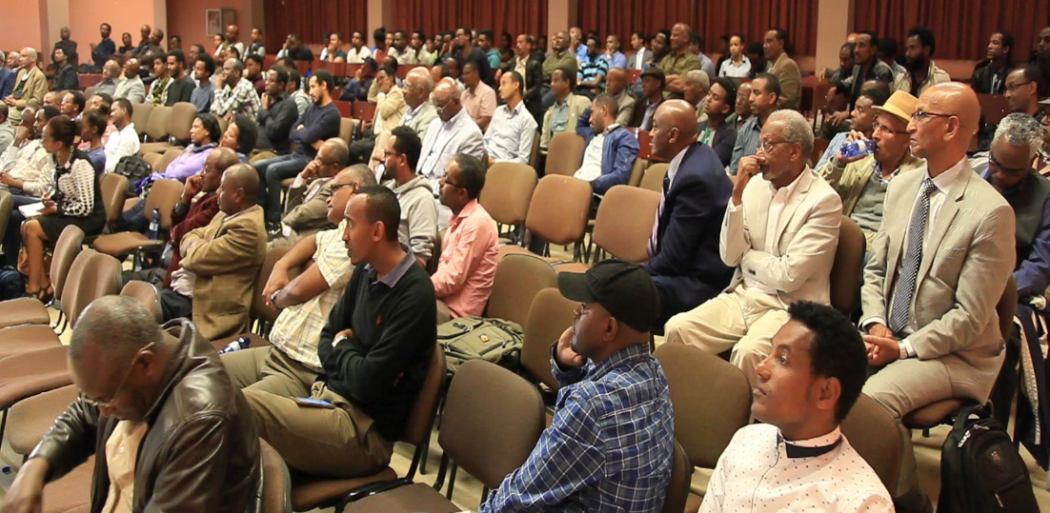
Monthly Public Lectures on topical issues
Lectures and Panel Discussion Issues from Agriculture, Health, Engineering, Natural Sciences, Social Sciences and Fine Arts
Targeted at raising awareness on basic and emerging sciences Engaged the public and scholars in discussions on topical issues
Panel discussion on Gender Equality

Slide 37
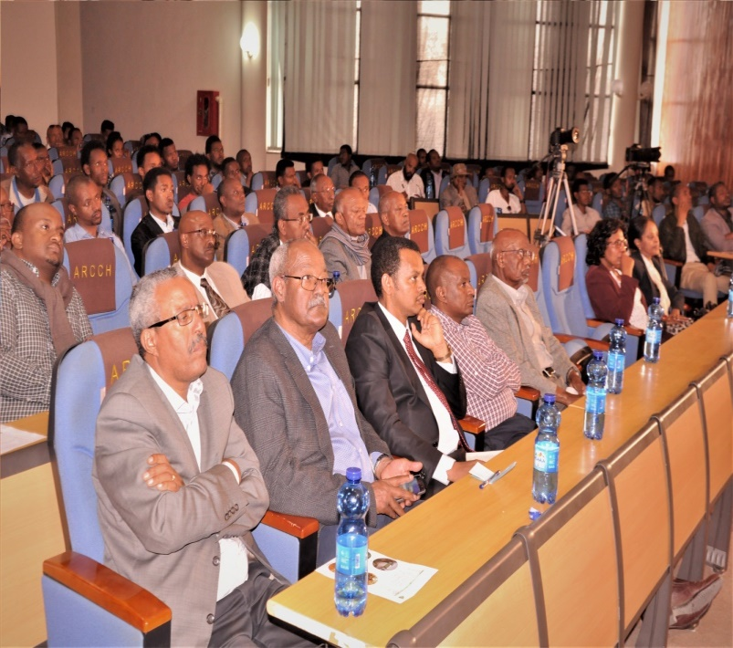
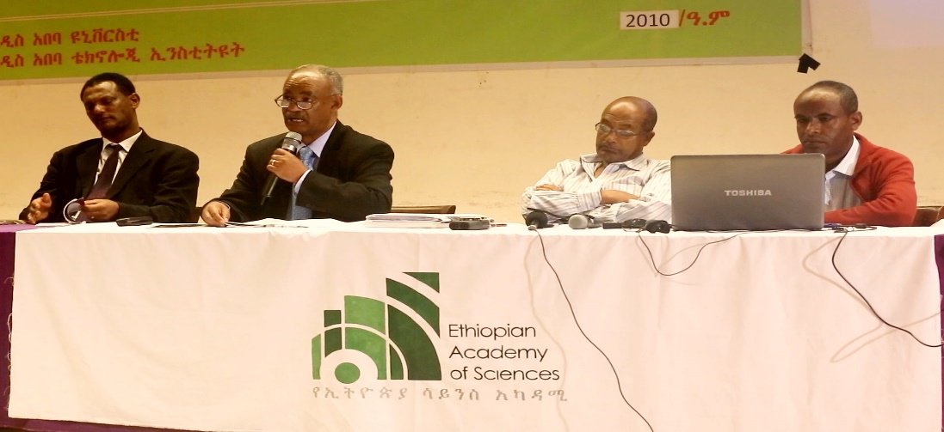
Monthly Public Lectures …
Participants include policymakers, secondary school and higher education students, researchers, Government officials and practitioners and representatives of the international community
Covered by local and international media
So far, 40 sessions conducted
Lecture on Artificial Intelligence

Slide 38

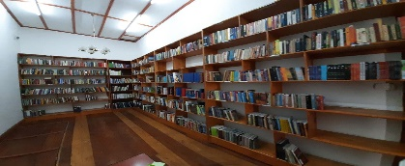
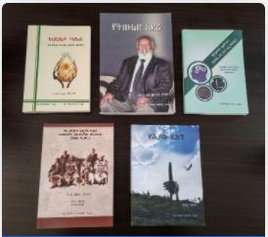
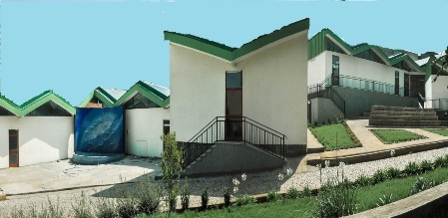
Institutional; Capacity Building
Established centers for the promotion of the knowledge and appreciation of the sciences and arts:
  Creative Arts Center
  EAS Library
  Ethiopian Academy Press
  Science Center (STEM, Children Center, Science Exhibits)

Slide 39
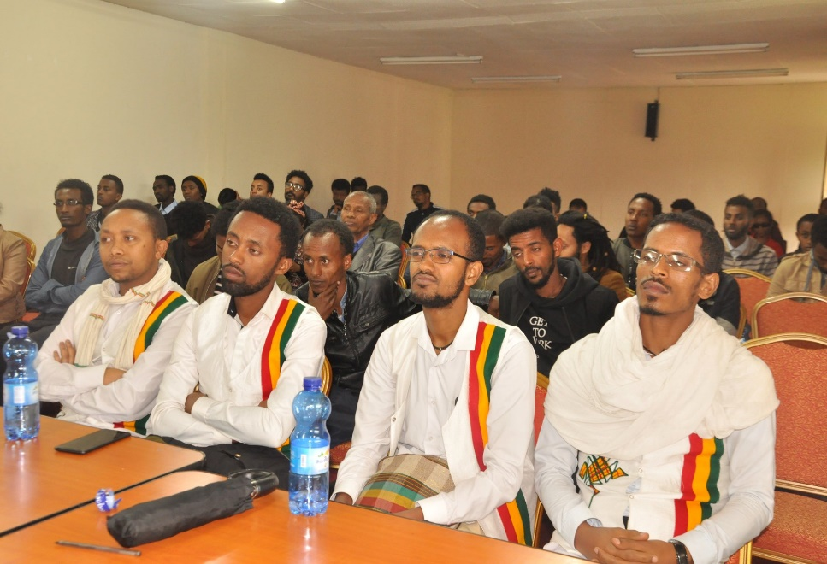
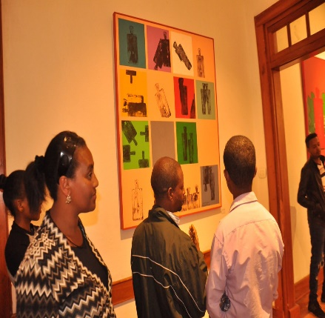
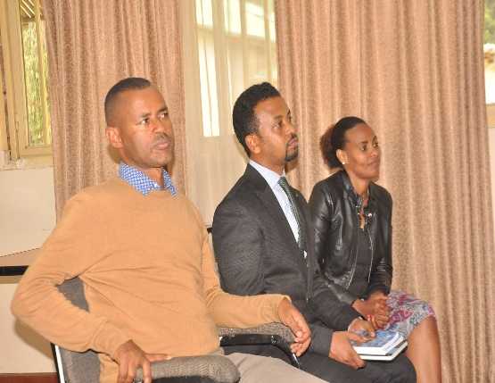
Creative Arts Center
Objectives
- Foster appreciation of the Ethiopian creative and performing arts
- Nurture imaginative and artistic expressions
- Bring arts and aesthetics closer to the peoples’ lives
- Empower and stimulate the arts and literary community on the arts
Create a discussion platform for arts
Serving as a meeting avenue for creative artists, authors, performers, and the general public

Slide 40




EAS Press
Publishes books by:
Various authors
The Academy

Slide 41

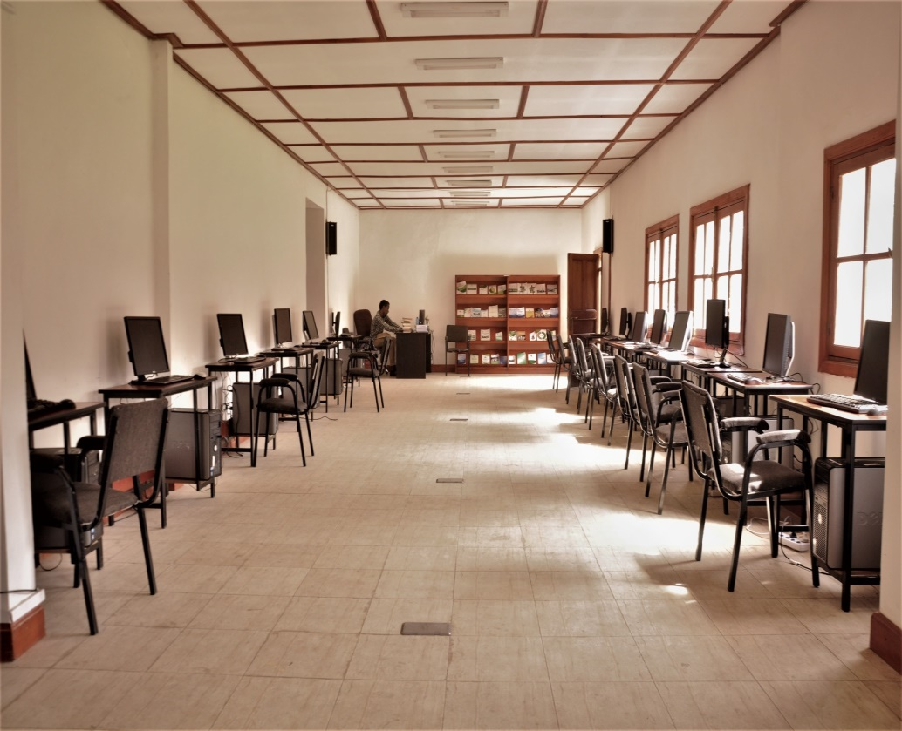
EAS Library
Objectives
- To nurture the culture of reading
- To help users meet their information and research needs
- To provide digital resources,
- To increase use of library resources and develop user skills
- To enhance personal development.
Collections
    Ethiopian/ African History
    Philosophy, Literature and Culture,
    Digital resources

Slide 42
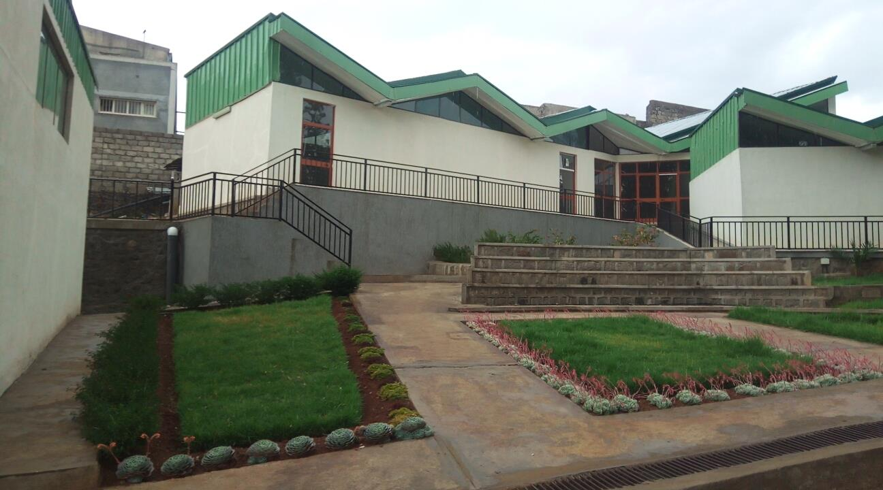

Science Center
Objectives
• Create a vibrant and dynamic public space where learning science is an enjoyable and engaging experience;
• Promote and foster interest in scientific curiosity and inquiry;
• Promote a flourishing culture of scientific enterprise

Slide 43



Networking with like minded academies and organizations
EAS is Member of IAP and NASAC
Has strong relations with:
  Science Academies in Africa (AAS, ASSAf, GAAS,
  KNAS NAS, UNAS,SNAS)
  US NAS
  The Royal Society of UK

Slide 44




Good Working Relations with:
  Ministry of Innovation and Technology
  Ministry of Science and Higher Education
  Ministry of Culture and Tourism
  Environment, Forest and Climate Change Commission
  National Planning Commission
  Universities and research institutes

Slide 45
Source of Funding for EAS Activities
Annual budgetary subvention from the Government (Birr 10 Million/Year)
Project based support from the Government (Birr 40 Million for the EAS SC)
Project and activity based funds from Ministries and other Government organizations
Annual contributions from Regular Fellows
Revenue from sales of publications
Project grants from international partners such as SIDA, IFS, Packard Foundation, IAP, INASP

Slide 46
EAS Publications
EAS has published over 50 publications in the form of:
  Consensus Reports
  Policy Briefs
  Congress and Workshop proceedings
  Annual reports
  Books

Slide 47
The Way Forward
Increasing Membership of the Academy with focus on gender balance (only 10% are women)
Ensuring sustainability of the Academy by mobilizing resources and establishing income generating enterprises
Building a well designed and equipped conference center at the Headquarters of the Academy
Conducting consensus studies on grand challenges facing the national development efforts
Organizing panel discussions on current topical issues in the country
Increasing visibility and relevance of the Academy through use of various mass media
Launching recognition of outstanding achievements in science, technology and innovation

Slide 48
Thank You

Slide 49
Impact of Science
23-25 June, 2021
Ian Wright
Deputy Vice-Chancellor of Research and Innovation, University of Canterbury, New Zealand
#IOS21

Slide 50
Industry-facing Research Centres – experiences from New Zealand
Professor Ian Wright
Deputy Vice-Chancellor (Research & Innovation)
University of Canterbury, Christchurch, New Zealand
AESIS: Academic – Business Relations for Innovation
June 2021

Slide 51
Presentation Outline:
New Zealand policy context and Government objectives;
Ecosystems of research, innovation, development, and commercialisation engagement;
Broad UC strategy of engaging with industry;
Examples of UC Research Centres engaging with various industry sectors;
Benefits and risks of industry research centres.

Slide 52
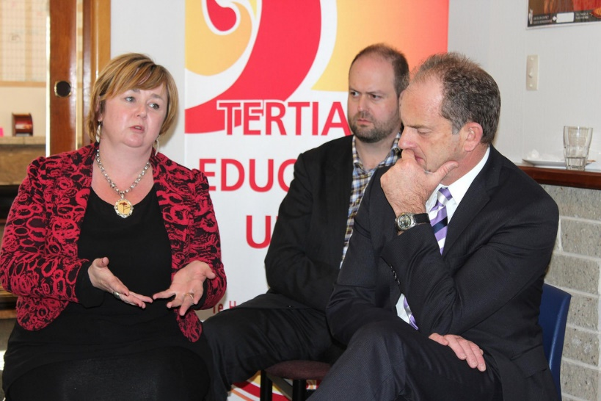
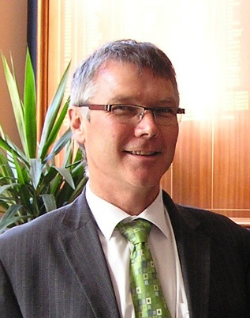
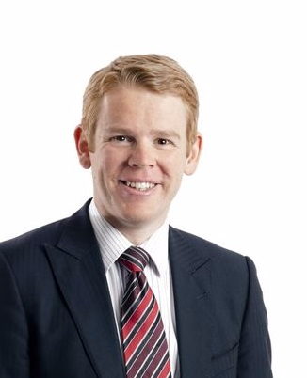
Policy Context
Supporting innovation including R&D tax credits;
Growing the volume and value of our exports;
Skills training and the productivity of the workforce;
Productivity enhancement;
Preparing for the changing nature of work, new technology, and climate change;
Unlocking new growth by infrastructure & technologies;
Regional economies growth.

Slide 53
Research – industry impact “spectrum”
Fundamental research
Academic “push”
Applied Research
Industry “pull”
Market
deployment
“Ecosystem”:
Opportunity to loop back and “nourish” R&D;
Connect with parallel & cognate innovations;
Research
innovation

Slide 54
Applied Research –
Industry-facing Research Centres
R & D
Prototype testing
Industry standards
Capability development
Partner for innovation funding
Professional development
Industry
University of Canterbury
Applied Research
Research Centres
Wireless Research Centre
Spatial Engineering Research Centre
EPECentre
QuakeCentre Research Centre
Aerospace “research cluster”
Fundamental Research
Academic Staff
Post-graduate Students
Infrastructure
Other Research Centres

Slide 55








Wireless Research Centre – industry partners
Industry-led research partnerships supporting local industry;
Team of researchers/engineers, with Post Graduate students;
Work closely with academics across the university;
Assist industry access funding to support their needs (eg Callaghan / MBIE);
Unique combined capability of wireless + geospatial expertise.
Founding industry partners/ major funders
Selected industry partners
Note: additional projects/partners bound by non-disclosure agreements

Slide 56
Broad research domains
Emerging wireless standards: Cellular, local area and personal area networks e.g., 5G/6G, Wi-Fi 6, Bluetooth LE
Broadband wireless: maximise throughput, coverage, availability, spectral & power efficiency, quality of service
Multi-antenna methods: channel modelling, estimation & equalisation, space-time coding, diversity, beamforming
Reliability: error control coding, diversity, scheduling
Flexibility: Software defined radio, heterogeneous systems
Application domain expertise: public safety, utilities, smart cities, precision agriculture.

Slide 57
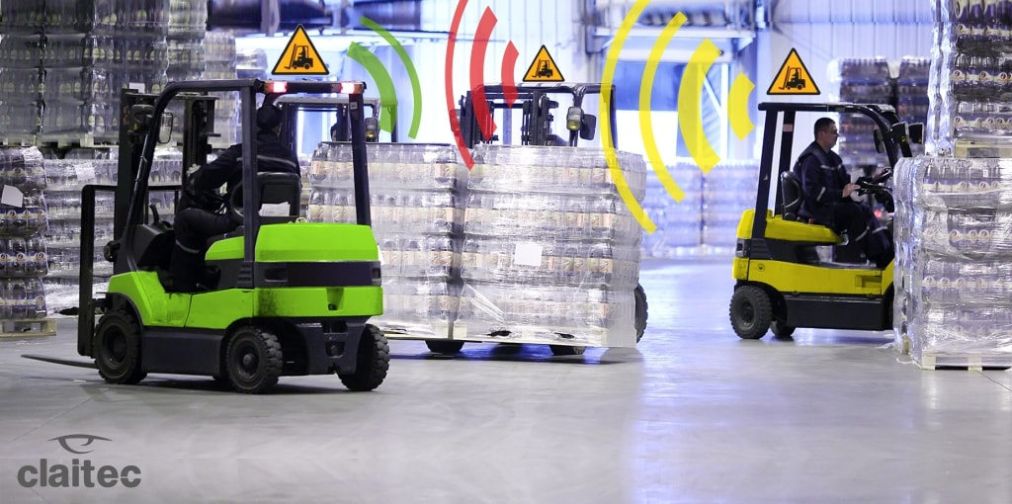
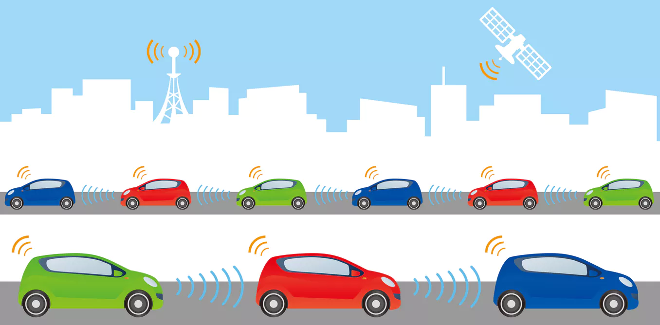
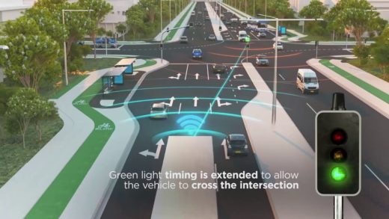
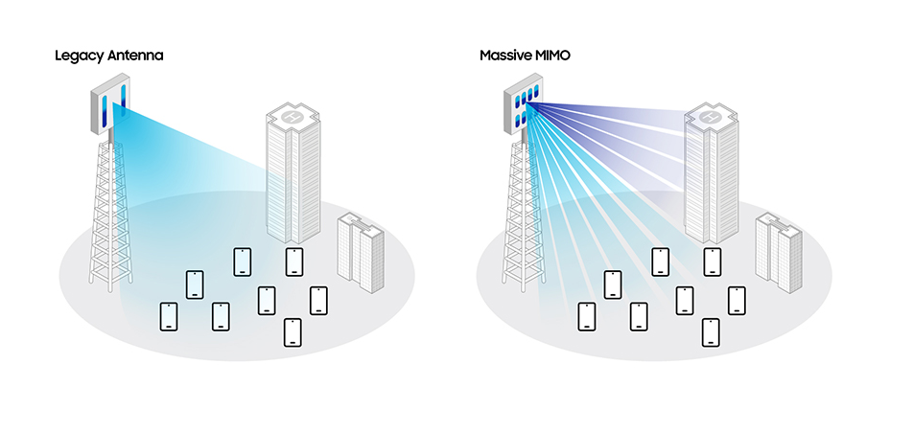
Research and applications
Multi-antenna technologies for 5G & beyond with 3D beamforming to support higher user densities and data rates.

Slide 58

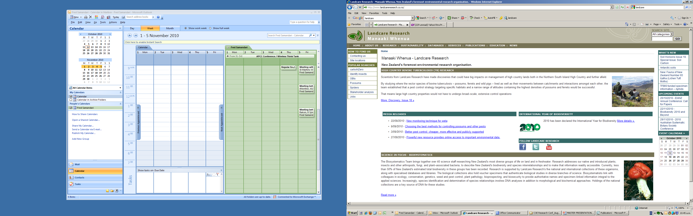






Spatial Engineering Research Centre
– industry partners
Note: additional projects/partners bound by non-disclosure agreements

Slide 59
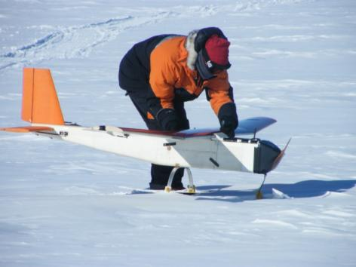
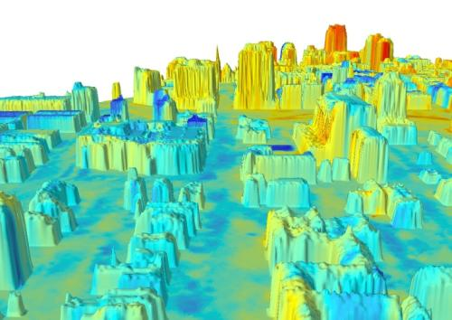
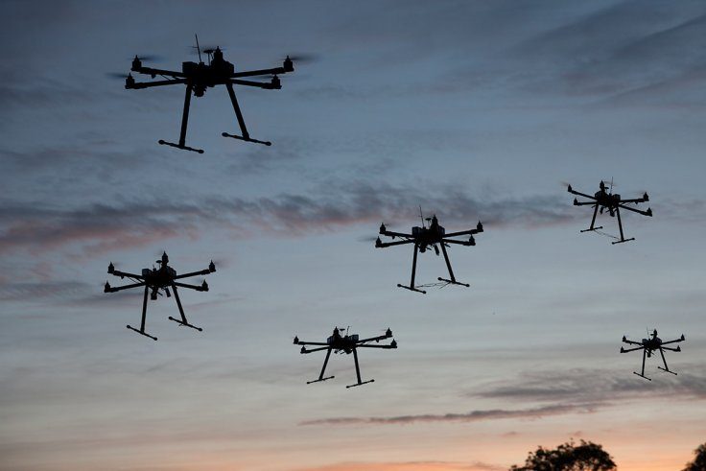
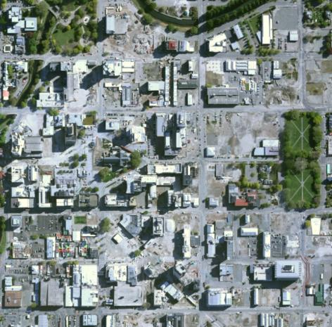
Research and applications
Combined LIDAR and thermal imaging; UAV swarming intelligence; autonomous aerial surveying; Antarctic UAV operations

Slide 60
EPEC Centre
Connection with over 50 national and international companies and active collaboration with over 25 of these
Connection with over 25 national and international universities and research centres and active collaboration with over 15 of these
A contact list developed through collaboration exceeding 1300.

Slide 61
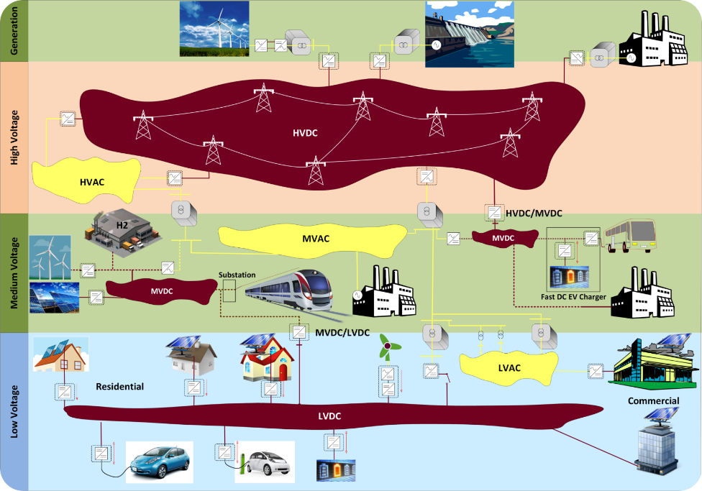
EPEC Centre
Assessing impact of high penetration of DC on AC systems;
Mega solar farm integration via HVDC
Transient & Steady State characterisation of long HVDC cables
Maximise performance - Active power electronic switching arrays

Slide 62
















UC Quake Centre - industry partners

Slide 63
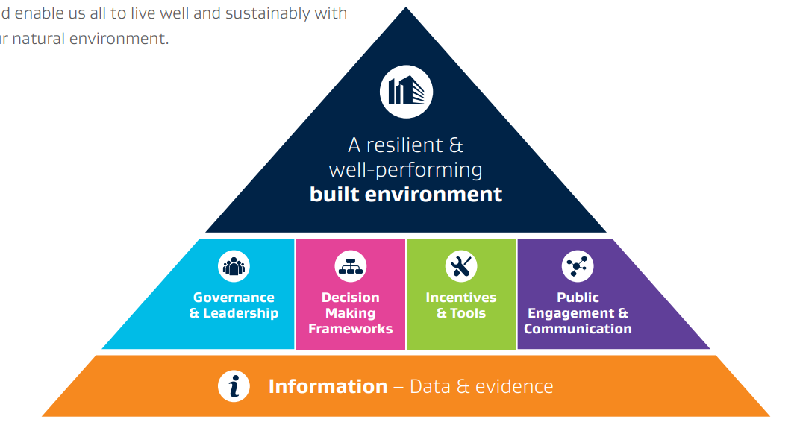
Future of Quake Centre
Covers horizontal and vertical infrastructure
Capability building and applied research platform
Coordinates, initiates and supports national infrastructure objectives
Uni. Auckland & Uni. Canterbury (all faculties) lead
Industry partners are co-promoters
All universities, CRI’s, central agencies, industry, peak bodies, polytechnics, other research entities
Source: Built Environment Leaders Forum Summary of Findings, 2017
A joint initiative of EQC, MBIE and BRANZ

Slide 64
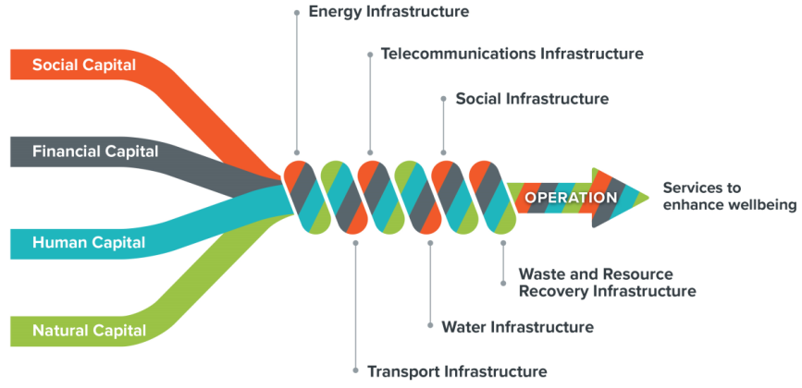
Future of infrastructure
Communities
Govt
Business
Communities
Govt
Source: The Infrastructure Commission
64

Slide 65
Observations: Risks & Benefits
Benefits:
Retains relevance of research;
Demonstration of innovation relevance;
Employment pathway for graduates;
Diversifies research / consultancy income;
Risks:
UC doesn’t retain right expertise as sector changes;
Centre strategy and governance is “captured” by industry;
Centre doesn’t / can’t evolve with change in innovation or market;
Business engagement is reliant on business model, ROI, and key relationships;

Slide 66
Questions for end of session?

Slide 67
Impact of Science
23-25 June, 2021
Thank you
#IOS21

